Slide 1
Object-oriented Programming
Week 6 | Lecture 1

Slide 2
Object Relationship
One of the advantages of an Object-Oriented programming language is code reuse.
There are two ways we can do code reuse either by the implementation of inheritance (IS-A relationship), or object composition (HAS-A relationship).

Slide 3
Object Relationship
Often, classes do not have to be created “from scratch.” Rather, they can include objects of other classes as members or they may be derived from other classes that provide attributes and behaviors the new classes can use. Such software reuse can greatly enhance productivity and simplify code maintenance. Including class objects as members of other classes is called composition or aggregation. Deriving new classes from existing classes is called inheritance

Slide 4
Object Relationship
is-a relationship (Achieved by inheritance)
has-a relationship (Achieved by composition)

Slide 5
has-a Relationship
In a has-a relationship, an object contains one or more objects of other classes as members
“Has-A” — An object has a subset of object
For example is :-
A rose has a leaf
A dog has a legs

Slide 6
has-a Relationship
Composition(HAS-A) simply mean the use of instance variables that are references to other objects.
For example, Maruti has Engine, or House has Bathroom.

Slide 7
Is-a Relationship
Use a car as an example. You could logically define a car as being a subclass of vehicle, so it inherits the properties of other vehicles. At the same time, a car has a motor. If you buy a car, you can logically assume that you are buying a motor as well.

Slide 8
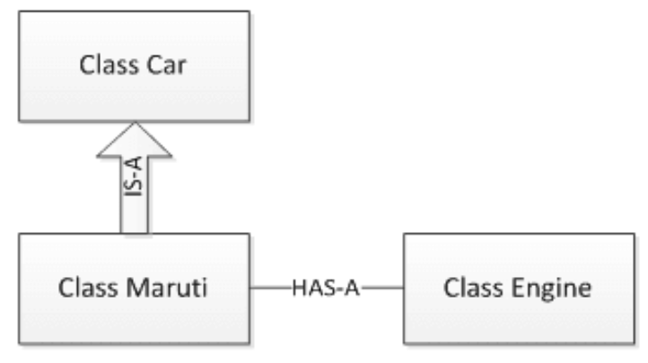
Example

Slide 9
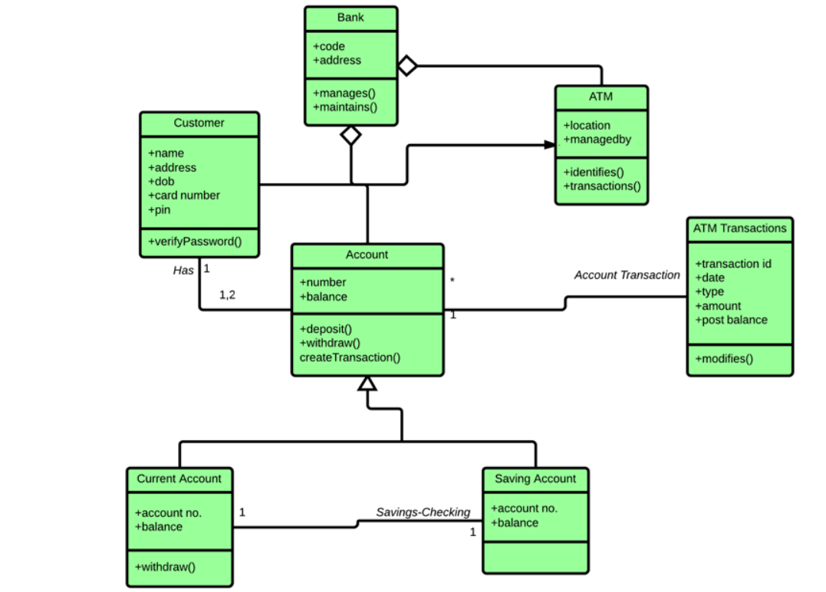

Slide 10
has-a Relationship
class Office
{
Department d;
// any other members
};

Slide 11
Example
Employee class has the reference of Address class as data member

Slide 12
Example
#include <iostream>
using namespace std;
class Address {
public:
string address;
void showAddress()
{
cout<<"C-146, Sec-15,Noida,UP" ;
}
};

Slide 13
Example
class Employee
{
private:
Address address; //Employee HAS-A Address
public:
getEmployeeAddress() {
address.showAddress();
}
};

Slide 14
Example
int main(void) {
Employee e1;
e1.getEmployeeAddress();
return 0;
}

Slide 15
Another Example
#include <iostream>
using namespace std;
class Address {
public:
string addressLine, city, state;
Address(string addressLine, string city, string state)
{
this->addressLine = addressLine;
this->city = city;
this->state = state;
}
};

Slide 16
Another Example
class Employee
{
private:
Address* address; //Employee HAS-A Address
public:
int id;
string name;
Employee(int id, string name, Address* address)
{
this->id = id;
this->name = name;
this->address = address;
}
void display()
{
cout<<id <<" "<<name<< " "<<
address->addressLine<< " "<< address->city<< " "<<address->state<<endl;
}
};

Slide 17
Another Example
int main() {
Address a1= Address("C-146, Sec-15","Noida","UP");
Employee e1 = Employee(101,"Nakul",&a1);
e1.display();
return 0;
}

Slide 18
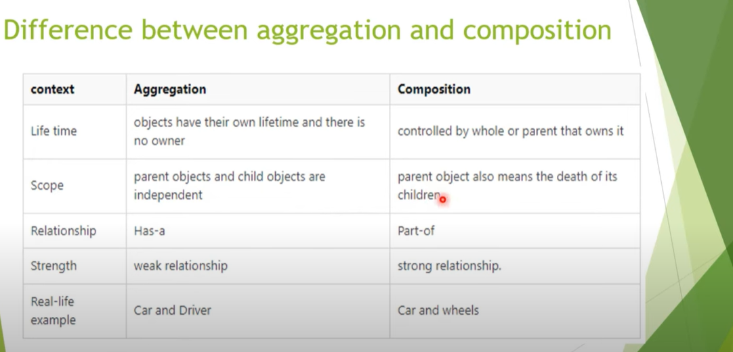
Aggregation and Composition

Slide 19

is-a Relationship
Sometimes, one class is an extension of another class
A car is a vehicle Cricket is a sport

Slide 20
is-a Relationship
The extended (or child) class contains all the features of its base (or parent) class, and may additionally have some unique features of its own
The key idea behind inheritance

Slide 21
Advantage
It Provides REUSABILITY and MAINTAINABLITY of CODE.

Slide 22
Exercise
when to use is a and has a relationship?
give some (at least one) real world example that implements is a and has a relationship

Slide 23

Next Lecture
Inheritance!

